Slide 1
OnBase AP Approvals
Blaine Smith – bsmith1@emporia.edu Patty Delmott – pdelmott@emporia.edu

Slide 2
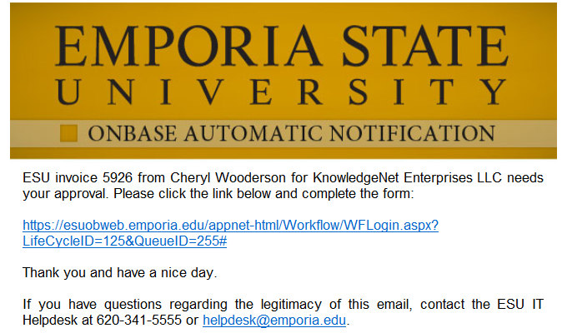
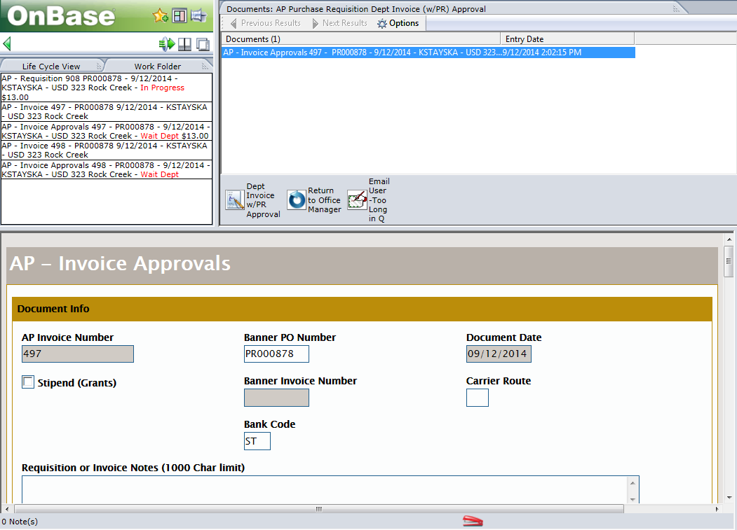
OnBase AP Approvals
OnBase Approvals – Easy as 1-2-3!
3)
1)
2)
Notes:
If you’re on campus and using a Windows PC with the correct IE settings for OnBase, approvals are as easy as 1-2-3.
Click the link approval notification link in your email.
Review the document.
Click the Approve (or Next Approver) Task Button to apply your approval and move the document forward in the process.

Slide 3
Overview
Accessing OnBase
Approving Documents
Document Retrieval
Additional Info
IE Settings / Off Campus Access / Mobile and Mac / Resources

Slide 4
Accessing OnBase
Email Notification Links
Logging Into OnBase Directly
SkyLab

Slide 5
Accessing OnBase – cont.
Email Notification Links
Notes:
-Automatic Email Notifications from the OnBase system may come from a user’s email address, a departmental email address, or a system email address.
-They will follow the basic format show on this slide.
-If you’re unsure of the validity of an OnBase notification, contact the IT Helpdesk.

Slide 6
Accessing OnBase – cont.
Email Notification Links – cont.
WorkflowPop
https://esuobweb.emporia.edu/appnet-html/Workflow/WFLogin.aspx?LifeCycleID=125&QueueID=255#
DocPop
https://esuobweb.emporia.edu/AppNet-html/docpop/docpop.aspx?clienttype=activex&docid=1153458&viewerOnlyForSingle=true
FolderPop
https://esuobweb.emporia.edu/AppNet/FolderPop/FolderPop.aspx?ID=300614&clienttype=html
Single-Click only!
Notes:
-WorkflowPop –Used when a document requires your approval. This will open the Workflow window with the Ad Hoc task buttons for routing.
-DocPop – Typically used as an FYI; when a document doesn’t require any action to be taken.
-FolderPop – Used to link the user to a set of documents in the Folder view. (Ex: Graduate Student Folder or Contracts Folder)
Pop windows will take you directly to the document or folder that needs your attention, but will not open in the full Web Client. If you’ll be working extensively in OnBase, it’s best to log into OnBase directly.
If opened while on the ESU network (and using the IE browser), OnBase should automatically display the content without having to manually log in. Note: Single-click these links when opening them from your email. If you double-click, you may open 2 OnBase windows causing the document to be locked in the 2nd window.

Slide 7
Accessing OnBase – cont.
Logging Into OnBase Directly
BuzzIn > OnBase
http://esuobweb.emporia.edu
Notes:
Since OnBase uses your network credentials for the auto-login, you don’t have to log into BuzzIn. You may find it easier to create a shortcut or bookmark directly to the OnBase login page. http://esuobweb.emporia.edu

Slide 8
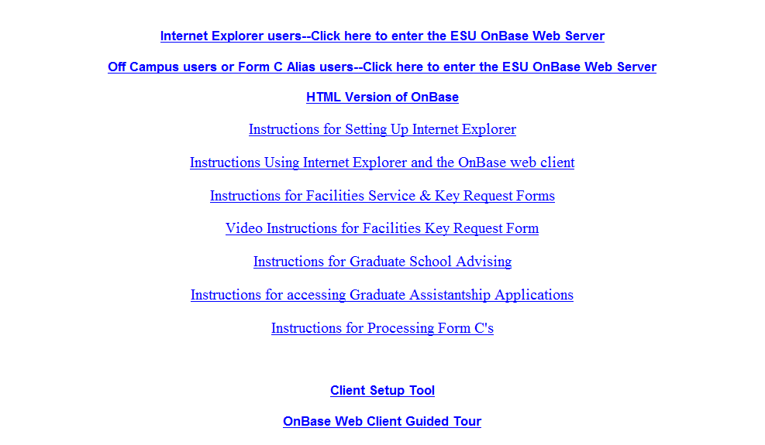
Accessing OnBase – cont.
Logging Directly Into OnBase – cont.
Notes:
In most cases, you will click the first link to be automatically logged into OnBase. This page will be replaced in the near future, but the top link will remain the primary point of entry.

Slide 9
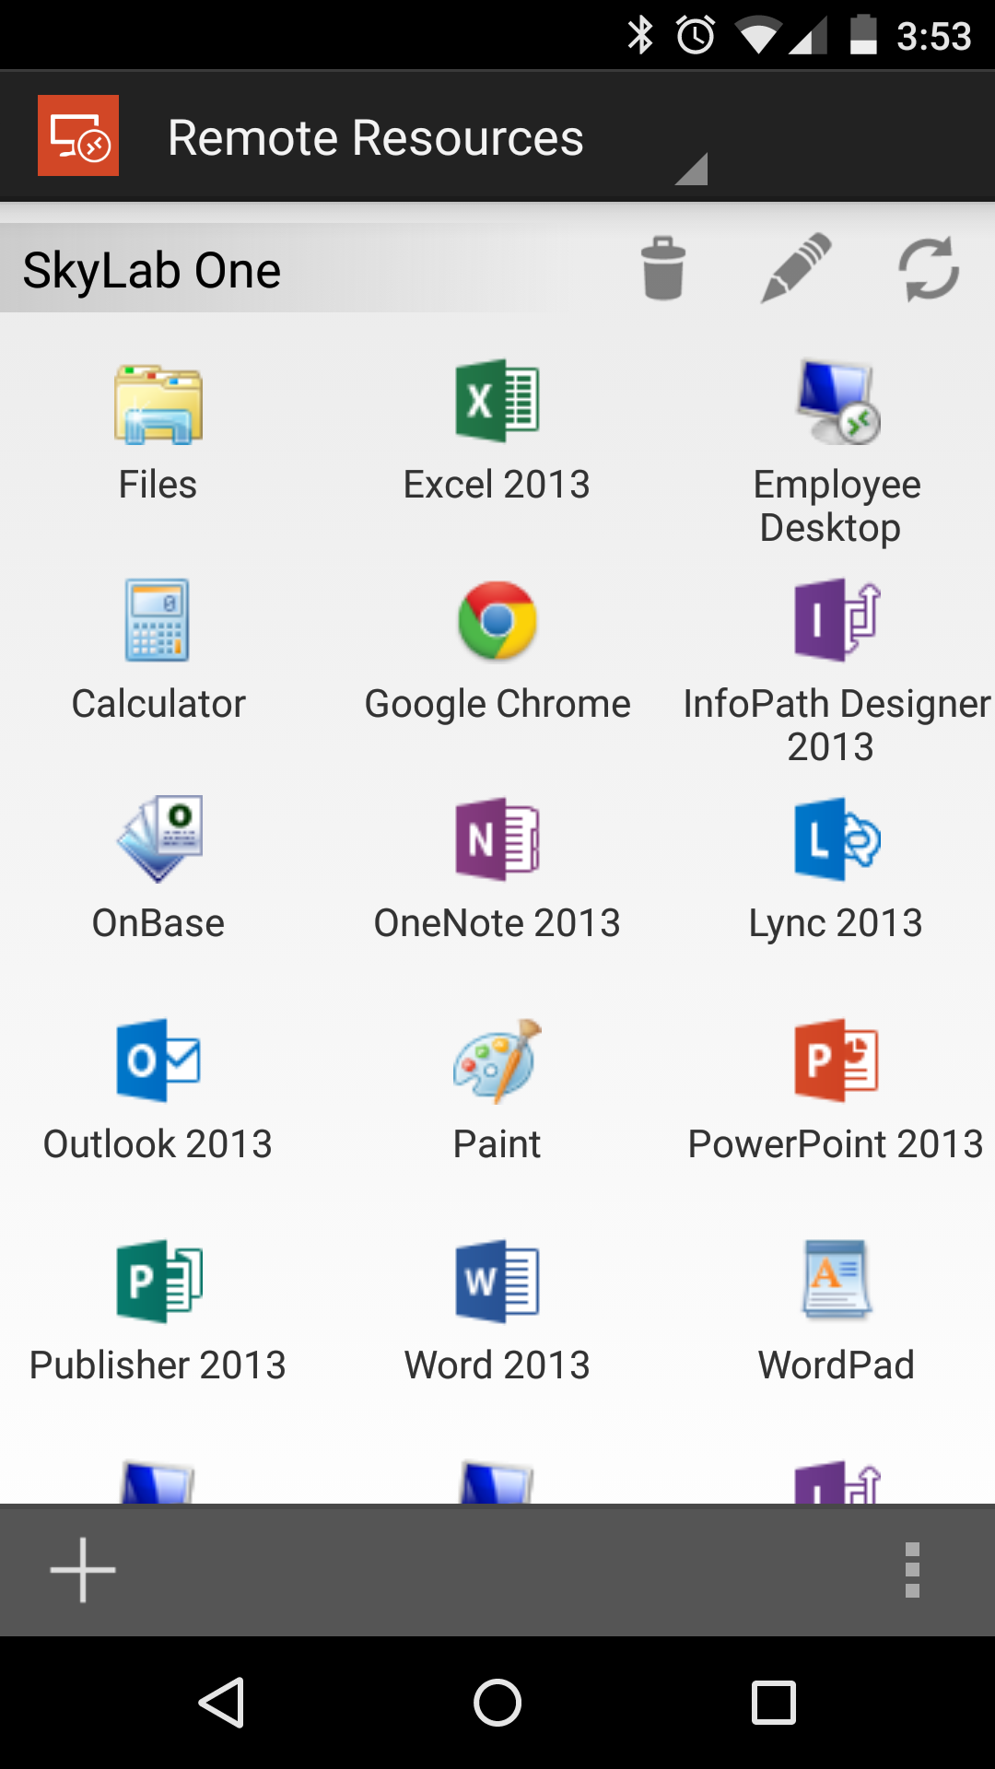
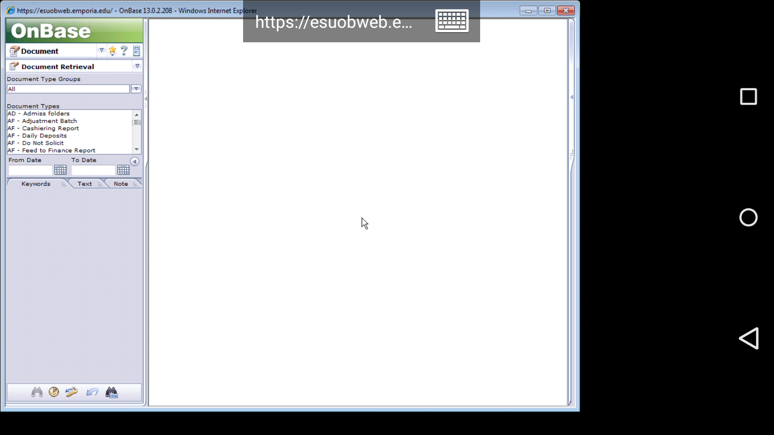
Accessing OnBase – cont.
SkyLab
http://sky.emporia.edu
Notes:
SkyLab is an option for Mac or Mobile users who need access to OnBase. It can even be used by Windows users who are having trouble accessing OnBase directly from their PC. For more information about SkyLab, visit sky.emporia.edu.

Slide 10
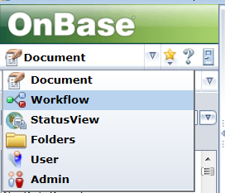
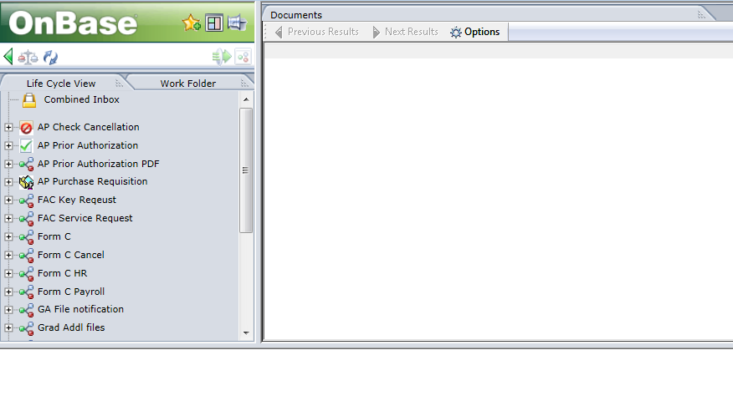
Approving Documents
OnBase Workflow Window
Notes:
To Approve Documents, you must be viewing the document in the Workflow window where you can see the ad hoc task buttons. Following a WorkflowPop email notification link should take you directly to the document within Workflow. Otherwise, you’ll need to navigate to the workflow window by selecting Workflow from the first drop-down list. (shows Document by default)

Slide 11
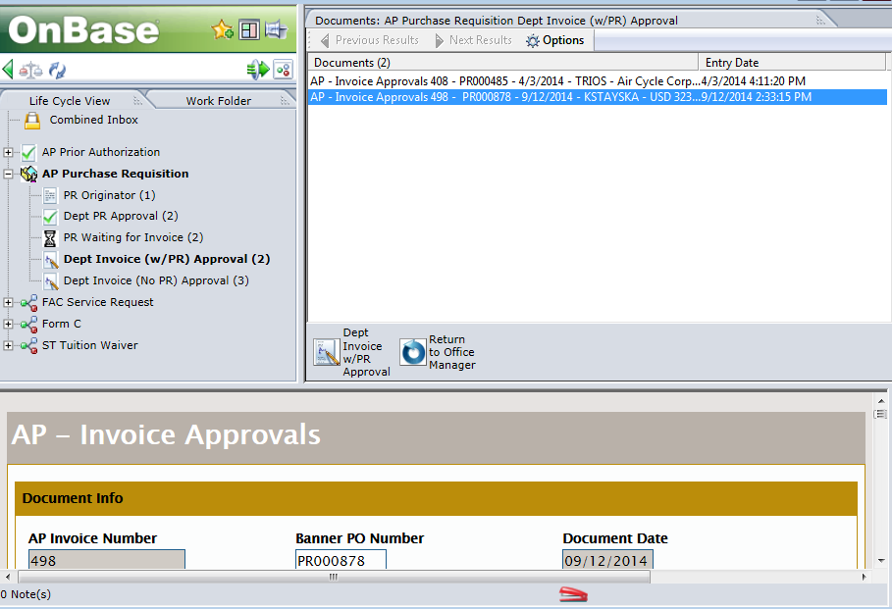
Approving Documents – cont.
OnBase Workflow Window – cont.
Click + to expand the Lifecycle
Click Queue you’ll be working in
Click Document in the list
Document is displayed below
Work Folder shows related documents (can be displayed in 2nd window)
Notes associated to the Document
Ad Hoc Task buttons to route the document
E)
C)
A)
B)
G)
D)
F)
Notes:
Unless you accessed the Workflow window via an email link, you’ll need to expand the Lifecycle and click the Queue you’ll be working in.
The Queue names will have a number next to them which represents the number of documents you have access to under each queue. The Workflow Window includes a lot of information about the documents displayed. This includes related documents that are displayed under the Work Folder as well as Notes which can be found in the lower-left of the window.

Slide 12
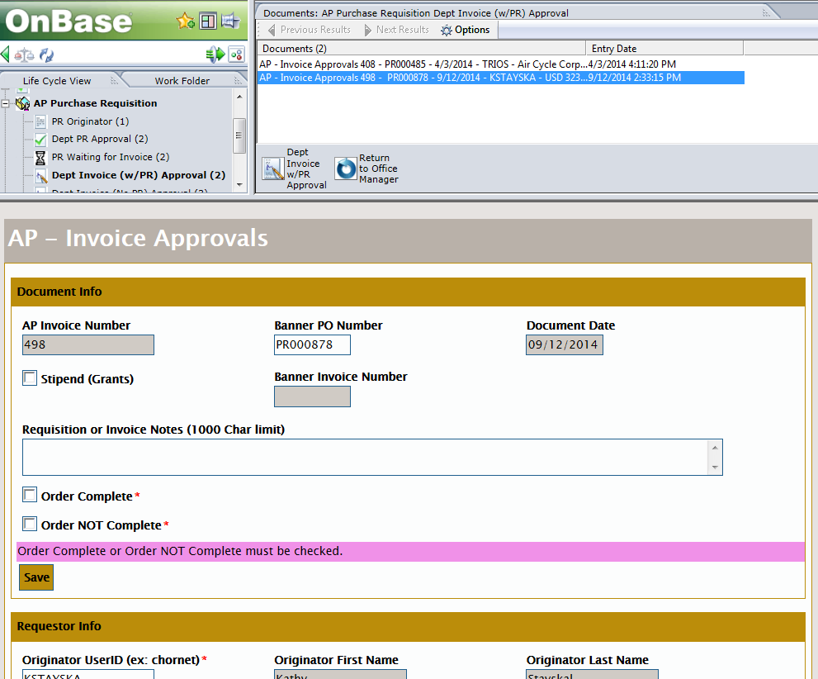
Approving Documents – cont.
OnBase Workflow Window – cont.
Save Button vs. Task Buttons
B)
The Save button is used to save any changes made to the document.
Task Buttons are used to route/process the document.
It is very important to click the save button on the document if any changes were made before routing the document.
A)
Notes:
If you make any changes to the document (ex: adding notes or attachments, etc.) it is very important to click the Save button on the document before clicking the Task Button to route the document. Otherwise, your changes may be lost. In many cases, however, the approver may not need to change anything on the document. When that is the case, simply review the document then click the Task Button to route the document to the Next Approver which will apply your approval in the process.

Slide 13
Approving Documents – cont.
OnBase Workflow Window – cont.
Route to Other User
The Route to other user feature should only be used when the routing deviates from the normal path.
Notes:
Depending on where the document is in the LifeCycle, you may see an option to route the form to another user. This should only be used when the routing will deviate from the normal approval path. For example, you may want a co-worker (who is not an approver) to view the form and add some details about the item being purchased before it is submitted for approval. This option is only available at the front-end of the process before the first approval is added. If the document requires no special routing, simply use the task buttons to route the document forward.

Slide 14
Document Retrieval
Retrieving/Querying a Document
Retrieval Tips and Tricks
Notes:
In most cases, you’ll have the ability to query/retrieve any document in OnBase that you’ve previously approved. Even if your level of approval wasn’t required, you can still view documents for your department. Performing a basic search in OnBase is easy, but OnBase is a powerful tool filled with many helpful features.

Slide 15
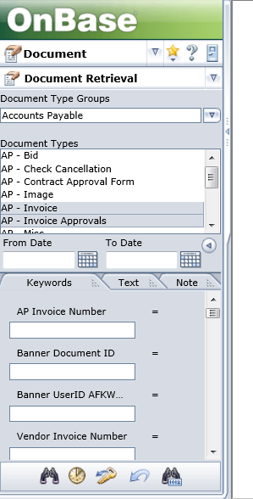
Document Retrieval – cont.
Retrieving/Querying a Document
Document Type Group – filters Document Types list
Select Doc Types to search (hold Ctrl or Shift to select multiple)
Provide a Document Date range
Provide any keywords to help narrow the search (if necessary)
Click the Search icon (binoculars)
A)
B)
C)
D)
E)
Notes:
To retrieve a document in OnBase that isn’t currently assigned to you in workflow, you’ll need to log into OnBase directly as discussed in an earlier slide. (through BuzzIn > OnBase)
The default view of the OnBase Web Client is set to the Retrieval window when you log in.
In some cases, it may be as simple as selecting the Document Type you’re searching for (ex: AP – Invoice Approvals), providing a date range, and clicking Search.
If you need to narrow the results, there are a number of keywords that can be used to find exactly what you’re looking for.

Slide 16
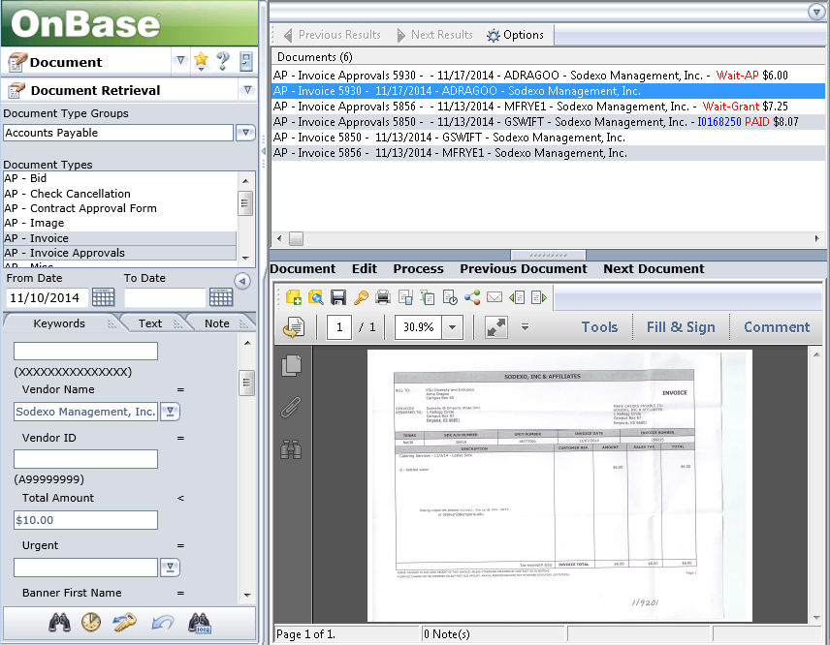
Document Retrieval – cont.
Retrieving/Querying a Document – cont.
Notes:
In this example, a retrieval was performed on both AP – Invoice and AP – Invoice Approvals Document Types. The Date Range was limited to anything after 11/10/2014. Keywords were provided to limit the results to only documents for Sodexo with an amount less than $10.00. The results are displayed in a list in the top-right pane. Double-clicking a item will display the document in the bottom-right pane. You will only be able to retrieve documents that you have rights to. Note: you cannot perform any workflow actions on the documents while in the Document Retrieval window.

Slide 17
Document Retrieval – cont.
Retrieval Tips and Tricks
Wildcard = *
Keyword Filter Options
Right-Click Menu Options
Notes:
Beyond the basic retrieval, OnBase is full of useful features if you know where to look.

Slide 18
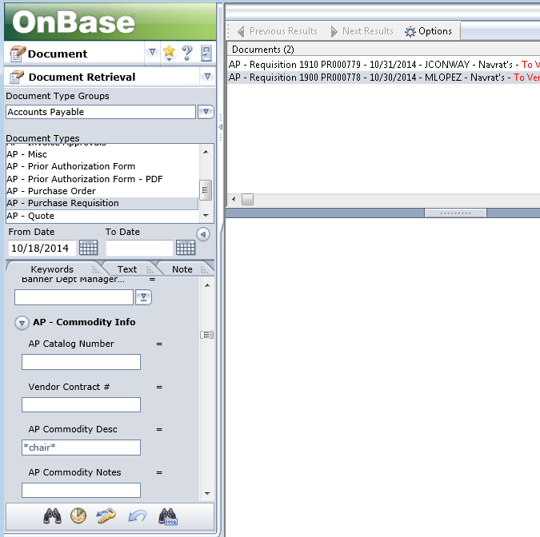
Document Retrieval – cont.
Retrieval Tips and Tricks – cont.
Wildcard = *
Notes:
The asterisk can be used as a wildcard when filter on a text-based keyword. For example, you may want to find all AP – Purchase Requisitions where the AP Commodity Desc keyword contained the string “chair”. To do this, simply place an asterisk before and after the desired search text. (ex: *chair*) In this search, there were 2 Purchase Requisitions after the selected date that had “chair” somewhere in the commodity description.

Slide 19
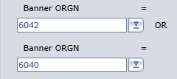
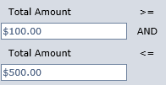
Document Retrieval – cont.
Retrieval Tips and Tricks – cont.
Keyword Filter Options
Notes:
You can also change how the keywords are filtered. By clicking the equals sign next to the keyword, you can change the filter to <> or (on date and numeric keywords) provide a less than / greater than criteria. Pressing F6 while your cursor is in a keyword field, or simply clicking on the keyword name will insert another instance of the keyword for filtering purposes. On this slide, we’re now wanting documents where the AP Commodity Desc does not contain “chair”. The Banner Orgn must either be 6042 OR 6040 and the Total Amount must be between $100 and $500.

Slide 20
Document Retrieval – cont.
Retrieval Tips and Tricks – cont.
Right-Click Menu Options
Keywords: displays a list of keywords attributed to the document
History: displays edit history and workflow history
Notes: displays notes associated to the document
Send To: saving to file, emailing, and creating a DocPop link
Create List Report: when multi docs selected, will save a list
Workflow: opens workflow or shows the progress of the document in workflow
Notes:
Once you’ve found the document you’re looking for, there is a lot of information about that document at your disposal beyond what you can see on the document itself. Many of these options can be found under the right-click menu. You can either right-click on the document itself or on the search result list. (after selecting an particular result) Most of these options are also available in the Workflow window.

Slide 21
Additional Info
IE Settings
Instructions for Setting Up Internet Explorer on esuobweb.emporia.edu
IT HelpDesk
Notes:
The full-featured OnBase Web Client is designed for Internet Explorer. There are some IE settings that, when set properly, will make your OnBase experience much nicer. Many (or all) of these settings are pre-configured by IT when you get a new computer. If you are being prompted to log into OnBase when using IE on the ESU network, a simple settings change will prevent that redundant login. See the instructions for setting up IE on the esuobweb.emporia.edu page or contact the IT HelpDesk for assistance in configuring your settings.

Slide 22
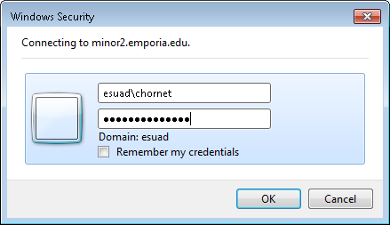
Additional Info – cont.
Off Campus Users
esuad\ before your userID (ex: esuad\chornet)
Notes:
When accessing OnBase from off the ESU network, you will need to enter esuad\ before your userID. For example: esuad\chornet. This will allow you to use your usual network credentials to access OnBase from outside the ESU network. In the prompt show on this slide, ensure esuad is displayed after Domain: Apart from that, you should access OnBase in the same way you normally would from on campus.

Slide 23
Additional Info – cont.
Mobile and Mac Users
http://sky.emporia.edu
Firefox ESR 24
Notes:
Our OnBase environment won’t support the latest and greatest Safari browser version until we’re able to upgrade to OnBase 14 sometime in 2015. We also recognize many users rely on their mobile devices to perform their daily functions. Fortunately, ESU has the SkyLab. This allows Mac and Mobile users to interact with ESU systems as though they were using a Windows PC.
Alternatively, Mac users can install Firefox ESR 24 to access OnBase directly from their machine. If you’re interested in using SkyLab or Firefox ESR on your Mac or Mobile device for OnBase, see sky.emporia.edu or contact Blaine Smith (bsmith1@emporia.edu) for more information.

Slide 24
Additional Info – cont.
Resources
OnBase Help
Documentation on esuobweb.emporia.edu
Hyland Resources
www.onbase.com/community/
www.training.onbase.com/
IT HelpDesk
OnBase Admins
Purchasing or Accounts Payable Office
Notes:
If you’re dying to learn more about OnBase, you have several resources available to you.
-OnBase Help – look for the Question Mark icon within the Web Client
-We have some process-specific documentation available on esuobweb.emporia.edu
-Hyland (the creator of OnBase) offers resources to their customers. Sign up using your emporia.edu email address.
-The IT HelpDesk can field most questions about OnBase
-The OnBase Administrators (Blaine Smith and Patty Delmott) won’t rest until you’re a happy OnBase user!
-The Purchasing and Accounts Payable Offices are happy to field questions related to the processing of Purchase Requisitions and Invoices.

Slide 25
The End
And They Lived Happily OnBase After
Questions?

